Slide 1

Exploratory Data Analysis
<G2M Insight for Cab Investment Firm>
<6/20/2022>

Slide 2
Agenda
Executive Summary
Problem Statement
Approach
EDA
EDA Summary
Recommendations

Slide 3
Executive Summary
Purpose: Find which company is performing better and is a better investment opportunity for XYZ?

Slide 4
Questions
Which company has more users?
Where do those users mainly reside?
How much money(profit) does each company earn?
Does each company have the same rate for expenses?
What is the demographic of the customers?

Slide 5
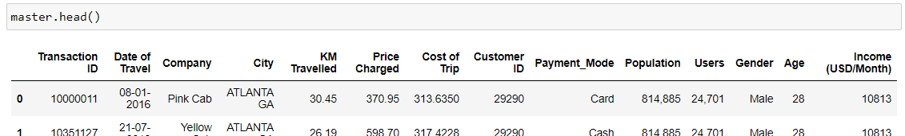
Master Dataset Info
Total number of observations | 359392
Total number of files | 4
Total number of features | 14
Base format of the file | csv
Size of the data | 42,293 KB

Slide 6
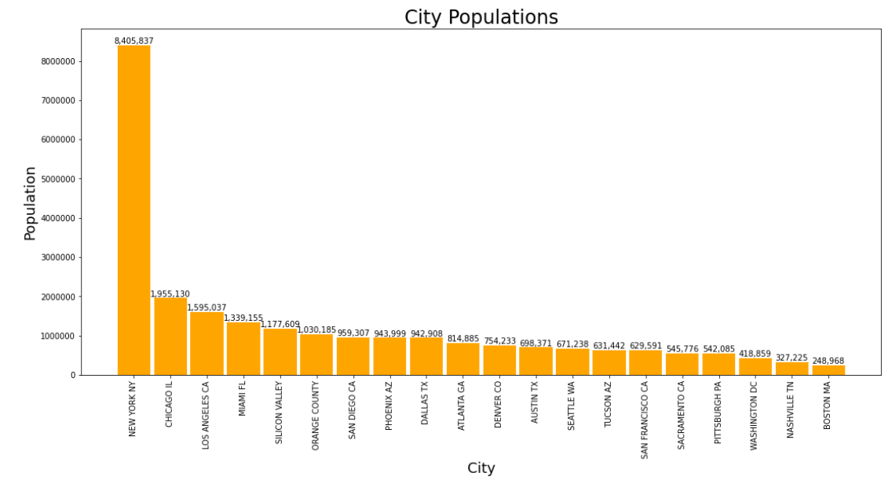
The most populated cities in order is New York, Chicago, Los Angeles, Miami, and Silicon Valley.

Slide 7
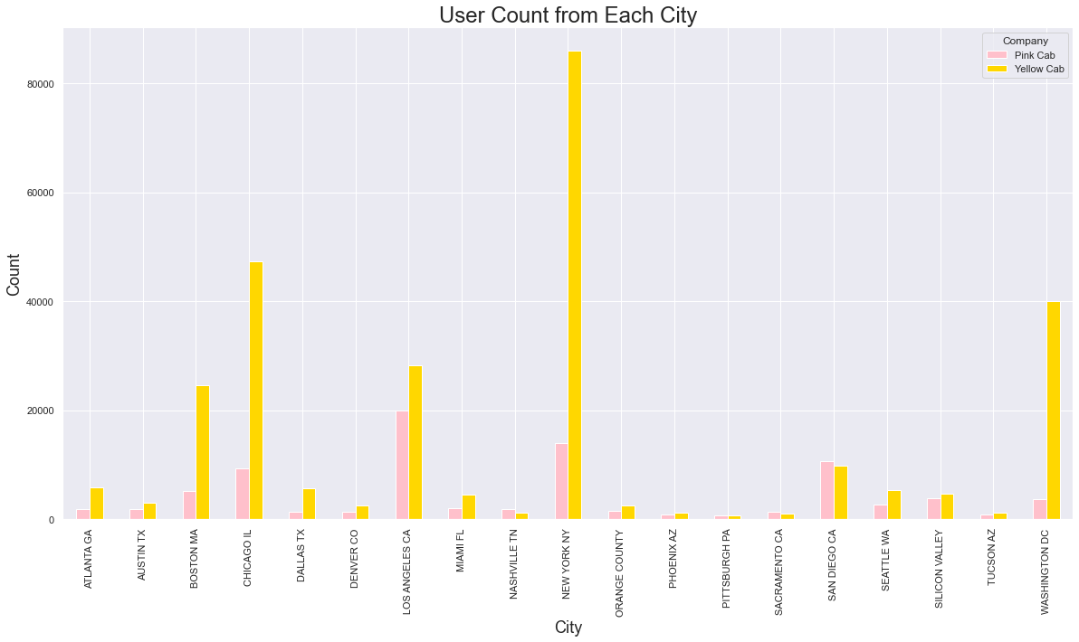
Yellow Cab has more users than Pink Cab in the top 5 most populated cities of the ones included.

Slide 8
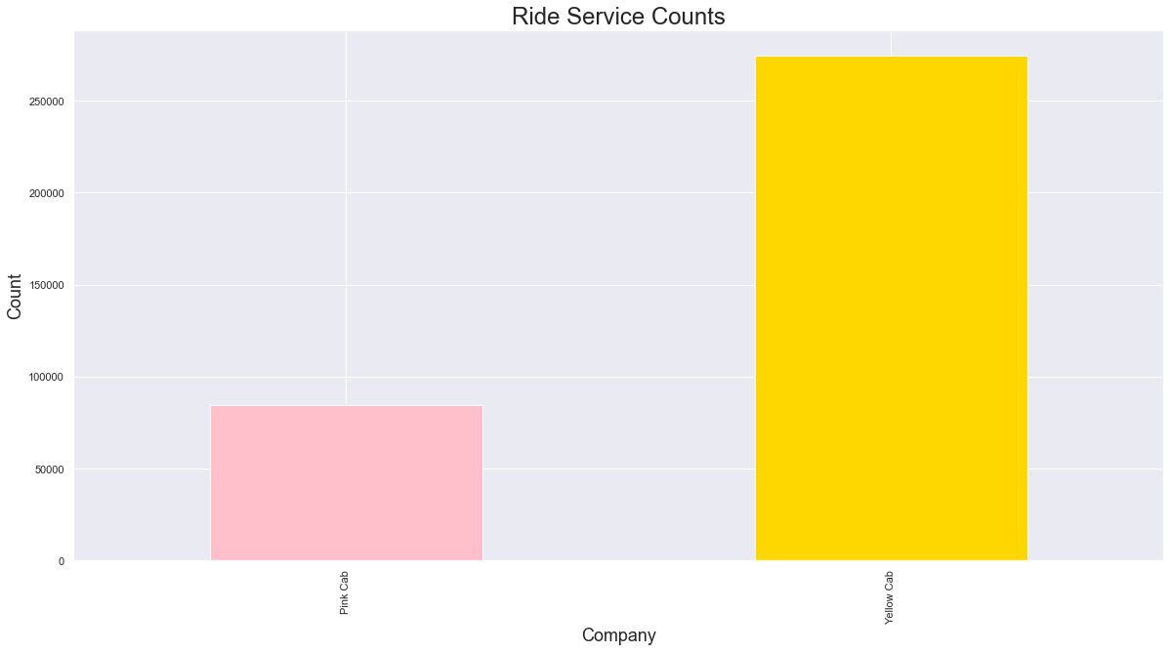
Yellow Cab has provided more rides than Pink Cab.

Slide 9
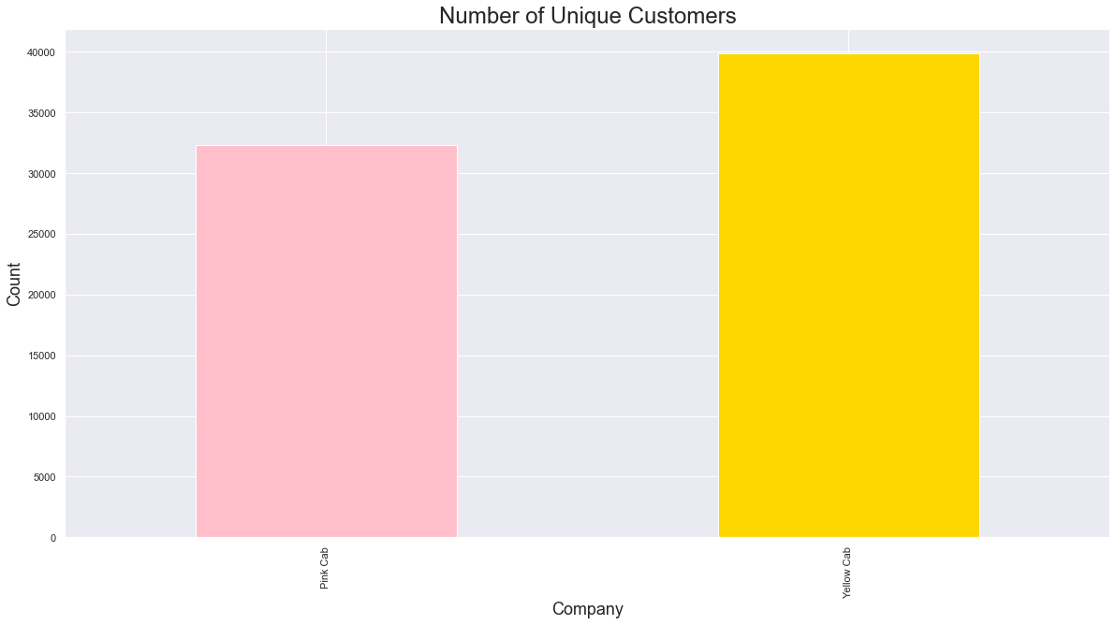
Yellow Cab has more unique customers.

Slide 10
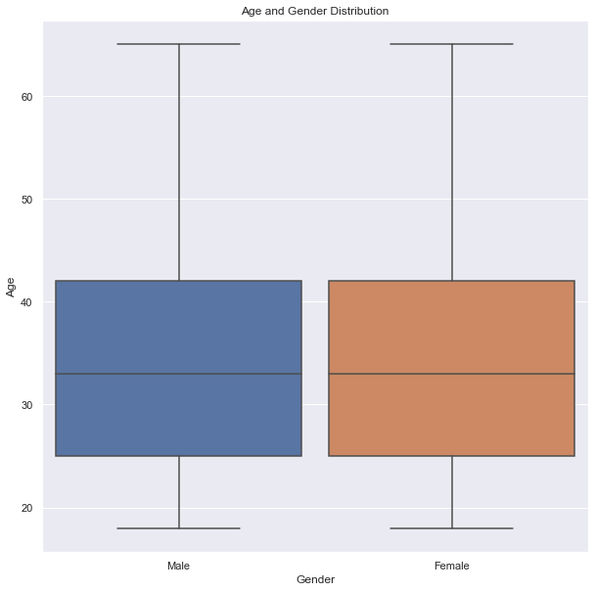
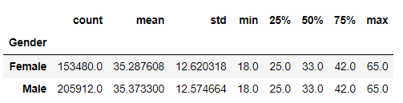
The Male and Female distributions are about the same. 50%of the demographic fall between the ages of 25 and 42.

Slide 11
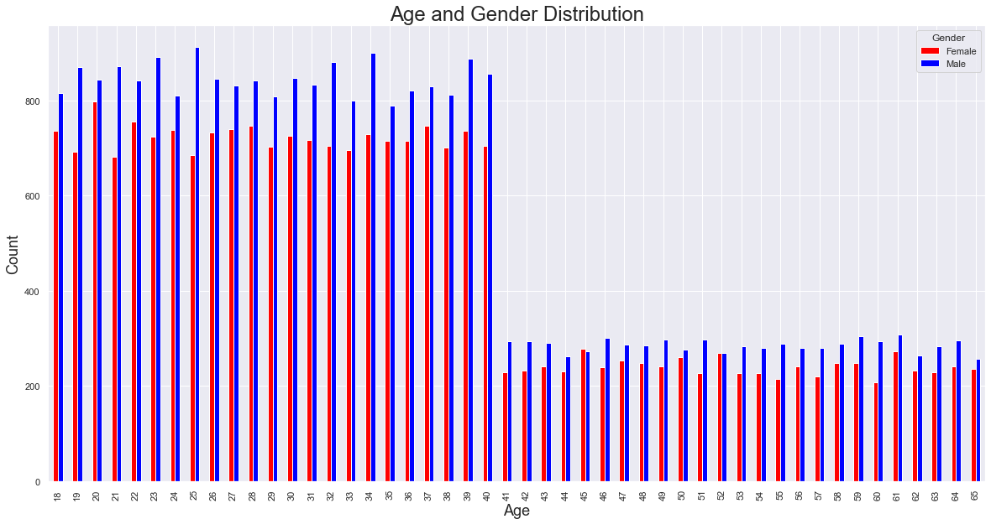
A majority of the users are at the age of 40 or below.

Slide 12
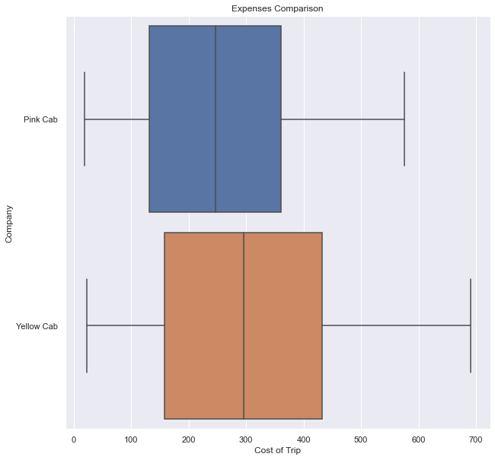
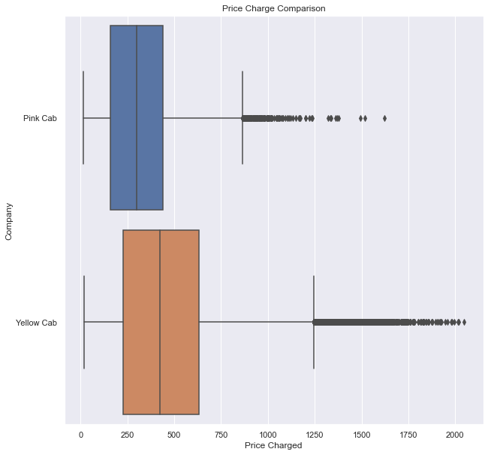
Yellow Cab spends more money per ride but also charges more.

Slide 13
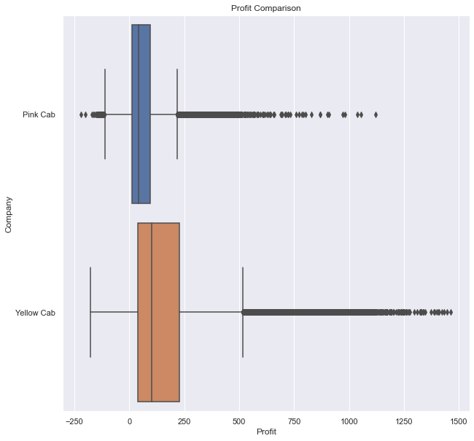
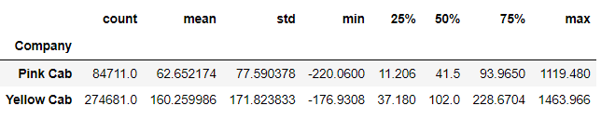
About 50% of the rides from Yellow Cab earn about $37.18 to $228.67.
About 50% of the rides from Pink Cab earn about $11.20 to $93.96.
The average profit per ride from Yellow Cab is more than double that of Pink Cab.

Slide 14
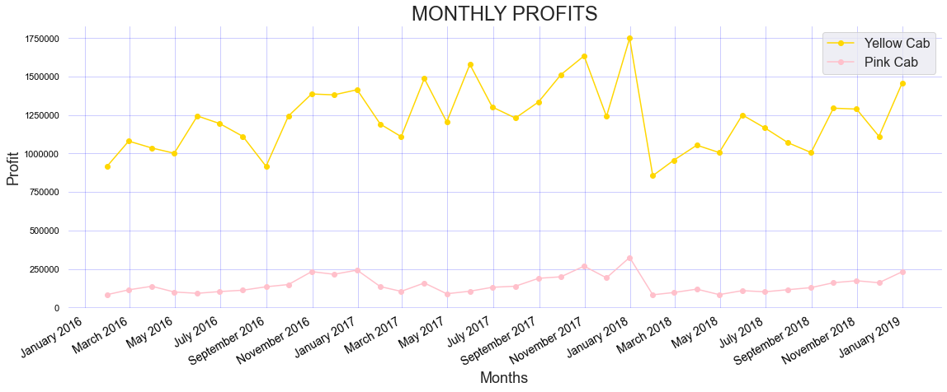
Yellow Cab has more profits in every month compared to Pink Cab.

Slide 15
Summary
- Yellow Cab company has much a wider customer pool in terms of unique users(different individual users).
- Yellow Cab has provided more rides in almost all of the cities that are shown.
- The most populated cities in order is New York, Chicago, Los Angeles, Miami, and Silicon Valley.
- They have provided more than 6 times the rides in New York city compared to Pink Cab.

Slide 16
Summary
- Yellow Cab has earned much more money per month than Pink Cab from 31/01/2016 to 31/12/2018 in ALL of the months.
- The average profit per ride from Yellow Cab(\\$160.25) is more than double that of Pink Cab(\\$62.65).
- The main demographic for customers are at the ages of 40 or below. Half of the demographic for customers are at the ages of 33 to 42.
- The age distributions for both companies are similar based from the boxplot.

Slide 17
EDA Recommendation
After reviewing and analyzing the data that has been provided, it is clear that Yellow Cab is a better investment than their competition in Pink Cab.

Slide 18
Thank You

